Slide 1
Practical II
Linear Traveltime Tomography

Slide 2
1.
The model problem
Linear traveltime tomography in 2-D

Slide 3
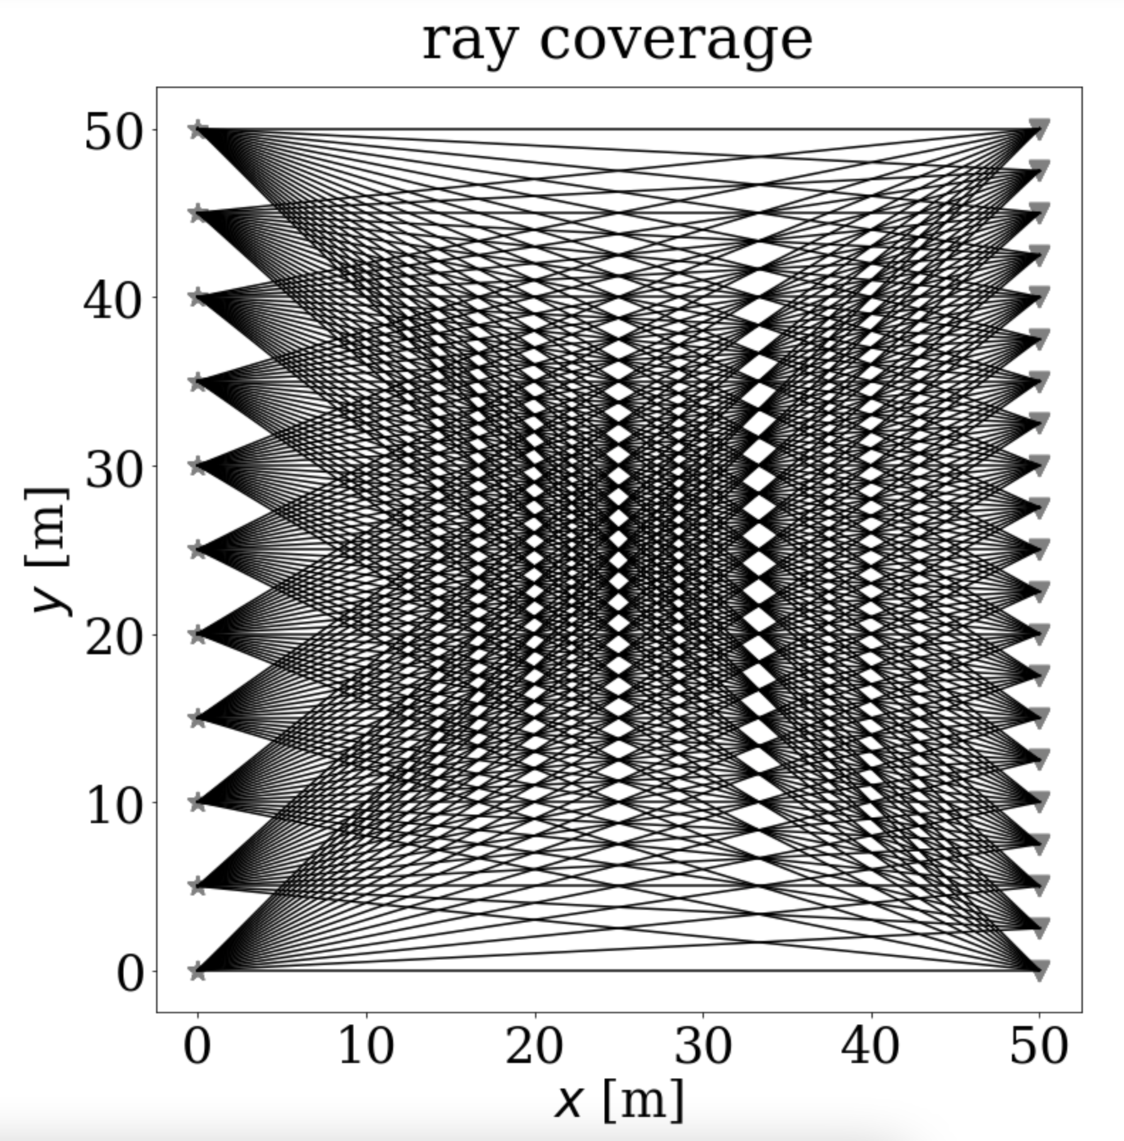
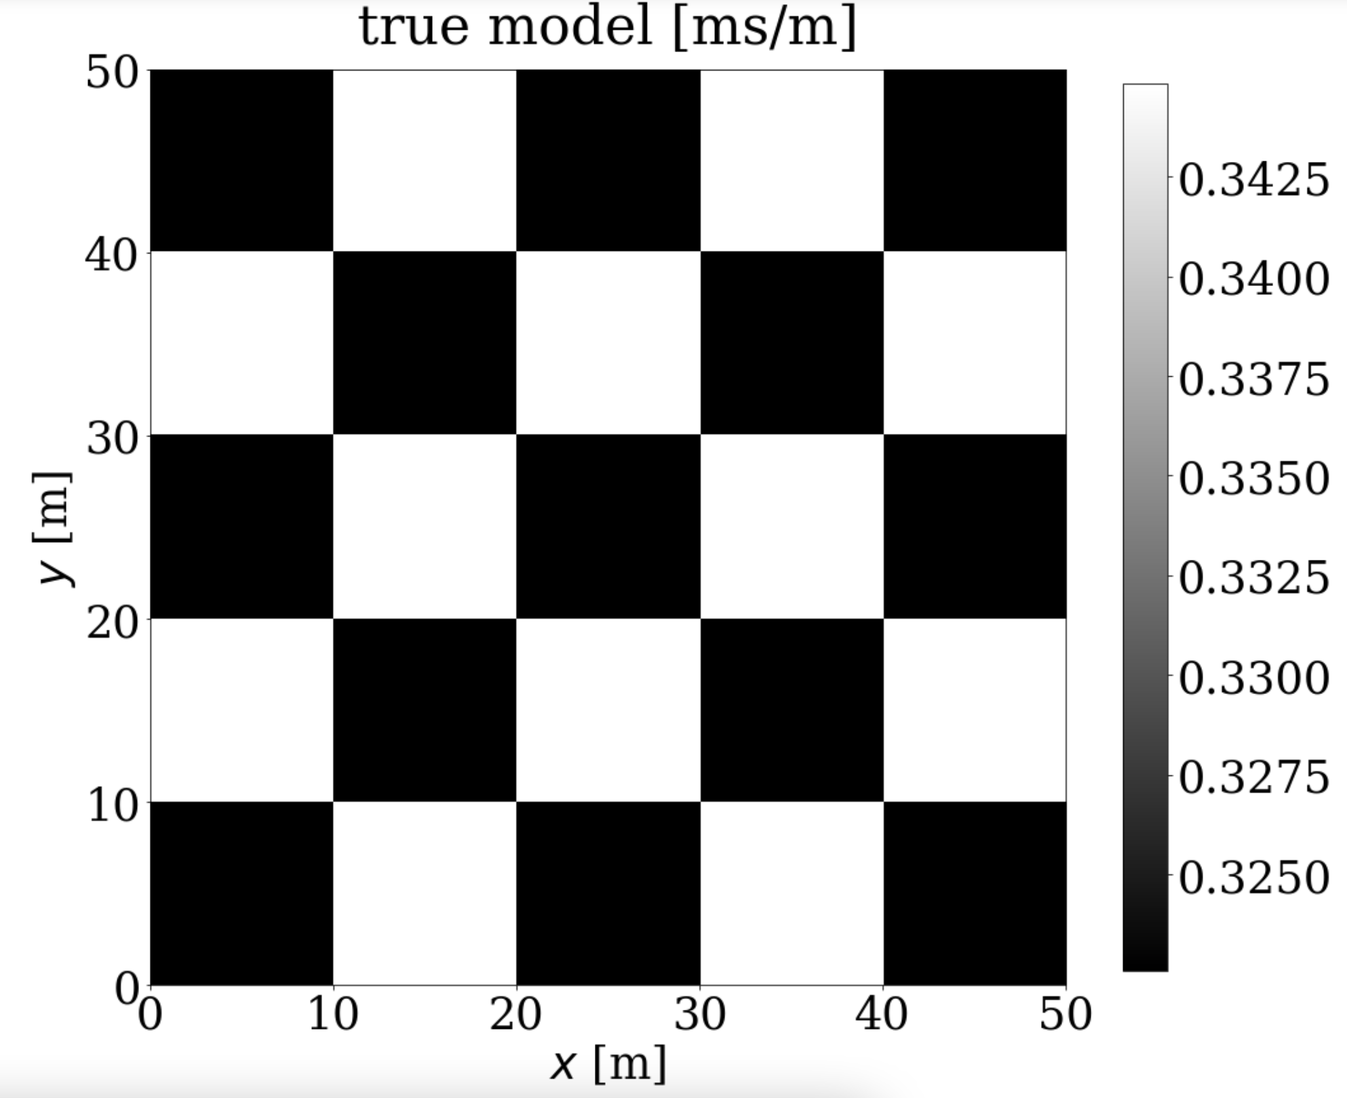
Tomography setup

Slide 4
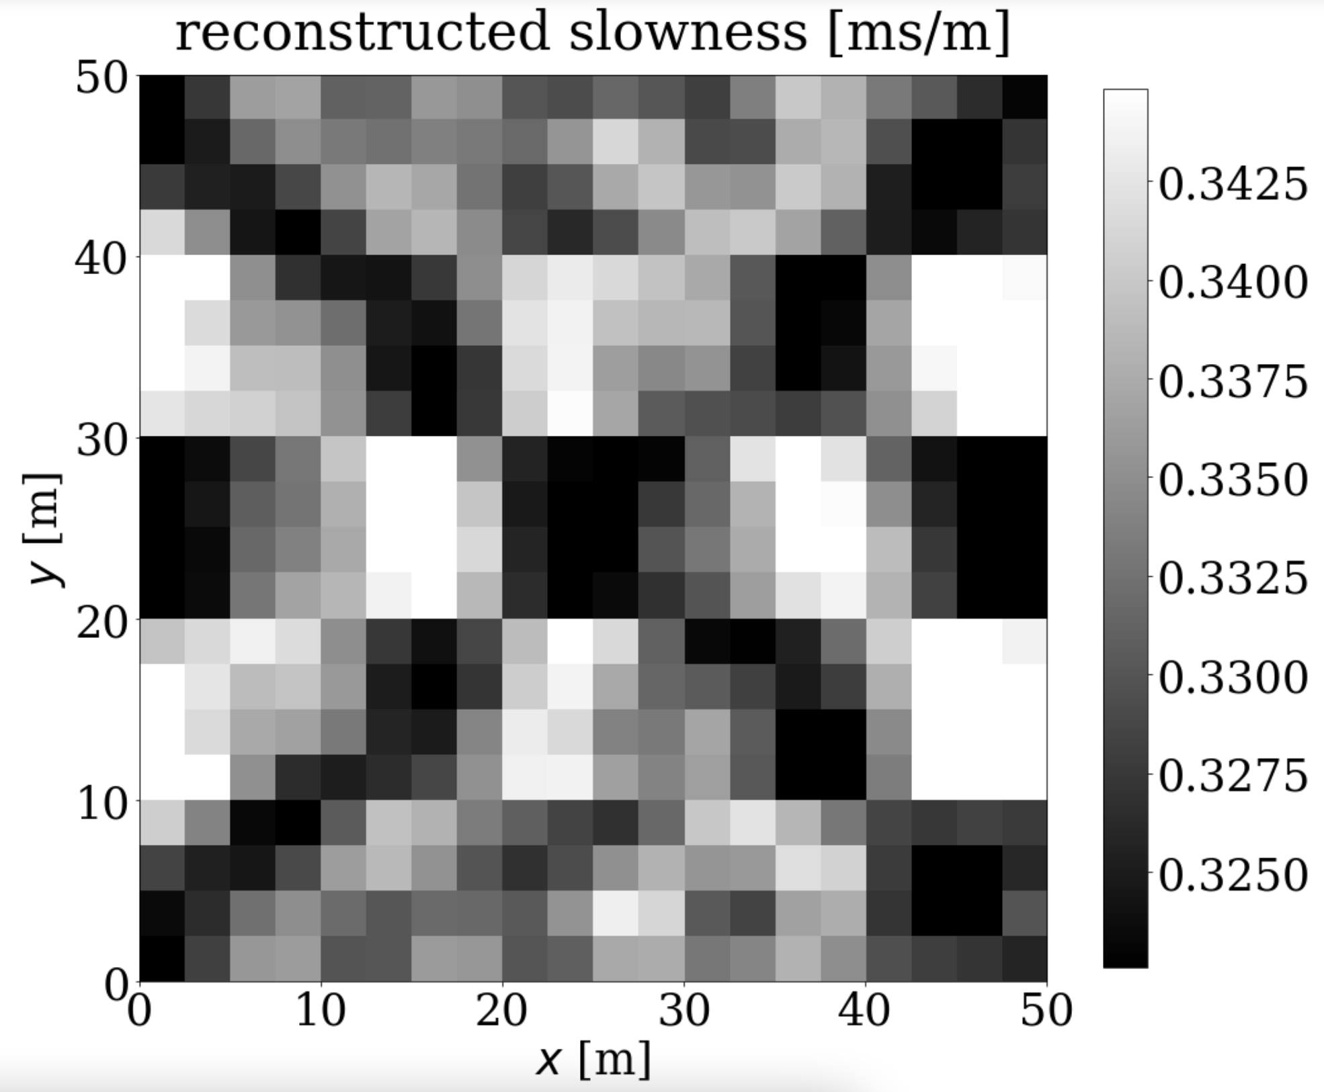
Least-squares solution

Slide 5
2.
Jupyter notebooks

